Slide 1
Software Requirements Analysis and Specification
Requirements
‹#›

Slide 2
Background
Problem of scale is a key issue for SE
For small scale, understand and specifying requirements is easy
For large problem - very hard; probably the hardest, most problematic and error prone
Input : user needs in minds of people
Output : precise statement of what the future system will do
Requirements
‹#›

Slide 3
Background..
Identifying and specifying req necessarily involves people interaction
Cannot be automated
Requirement (IEEE)= A condition or capability that must be possessed by a system
Req. phase ends with a software requirements specification (SRS) document
SRS specifies what the proposed system should do
Requirements
‹#›

Slide 4
Background..
Requirements understanding is hard
Visualizing a future system is difficult
Capability of the future system not clear, hence needs not clear
Requirements change with time
…
Essential to do a proper analysis and specification of requirements
Requirements
‹#›

Slide 5
Need for SRS
SRS establishes basis of agreement between the user and the supplier.
Users needs have to be satisfied, but user may not understand software
Developers will develop the system, but may not know about problem domain
SRS is the medium to bridge the commn. gap and specify user needs in a manner both can understand
Requirements
‹#›

Slide 6
Need for SRS…
Helps user understand his needs.
users do not always know their needs
must analyze and understand the potential
the goal is not just to automate a manual system, but also to add value through IT
The req process helps clarify needs
SRS provides a reference for validation of the final product
Clear understanding about what is expected.
Validation - “ SW satisfies the SRS “
Requirements
‹#›

Slide 7
Need for SRS…
High quality SRS essential for high Quality SW
Requirement errors get manifested in final sw
to satisfy the quality objective, must begin with high quality SRS
Requirements defects are not few
25% of all defects in one case; 54% of all defects found after UT
80 defects in A7 that resulted in change requests
500 / 250 defects in previously approved SRS.
Requirements
‹#›

Slide 8
Need for SRS…
Good SRS reduces the development cost
SRS errors are expensive to fix later
Req. changes can cost a lot (up to 40%)
Good SRS can minimize changes and errors
Substantial savings; extra effort spent during req. saves multiple times that effort
An Example
Cost of fixing errors in req. , design , coding , acceptance testing and operation are 2 , 5 , 15 , 50 , 150 person-months
Requirements
‹#›

Slide 9
Need for SRS…
Example …
After req. phase 65% req errs detected in design , 2% in coding, 30% in Acceptance testing, 3% during operation
If 50 requirement errors are not removed in the req. phase, the total cost 32.5 *5 + 1*15 + 15*50 + 1.5*150 = 1152 hrs
If 100 person-hours invested additionally in req to catch these 50 defects , then development cost could be reduced by 1152 person-hours.
Net reduction in cost is 1052 person-hours
Requirements
‹#›

Slide 10
Requirements Process
Sequence of steps that need to be performed to convert user needs into SRS
Process has to elicit needs and requirements and clearly specifies it
Basic activities
problem or requirement analysis
requirement specification
validation
Analysis involves elicitation and is the hardest
Requirements
‹#›

Slide 11
Requirements Process..
needs
Analysis
Specification
Validation
Requirements
‹#›

Slide 12
Requirement process..
Process is not linear, it is iterative and parallel
Overlap between phases - some parts may be analyzed and specified
Specification itself may help analysis
Validation can show gaps that can lead to further analysis and spec
Requirements
‹#›

Slide 13
Requirements Process…
Focus of analysis is on understanding the desired systems and it’s requirements
Divide and conquer is the basic strategy
decompose into small parts, understand each part and relation between parts
Large volumes of information is generated
organizing them is a key
Techniques like data flow diagrams, object diagrams etc. used in the analysis
Requirements
‹#›

Slide 14
Requirements Process..
Transition from analysis to specs is hard
in specs, external behavior specified
during analysis, structure and domain are understood
analysis structures helps in specification, but the transition is not final
methods of analysis are similar to that of design, but objective and scope different
analysis deals with the problem domain, whereas design deals with solution domain
Requirements
‹#›

Slide 15
Problem Analysis
Aim: to gain an understanding of the needs, requirements, and constraints on the software
Analysis involves
interviewing client and users
reading manuals
studying current systems
helping client/users understand new possibilities
Like becoming a consultant
Must understand the working of the organization , client and users
Requirements
‹#›

Slide 16
Problem Analysis…
Some issues
Obtaining the necessary information
Brainstorming: interacting with clients to establish desired properties
Information organization, as large amount of info. gets collected
Ensuring completeness
Ensuring consistency
Avoiding internal design
Requirements
‹#›

Slide 17
Problem Analysis…
Interpersonal issues are important
Communication skills are very important
Basic principle: problem partition
Partition w.r.t what?
Object - OO analysis
Function - structural analysis
Events in the system – event partitioning
Projection - get different views
Will discuss few different analysis techniques
Requirements
‹#›

Slide 18
Informal Approach to Analysis
No defined methodology; info obtained through analysis, observation, interaction, discussions,…
No formal model of the system built
Obtained info organized in the SRS; SRS reviewed with clients
Relies on analyst experience and feedback from clients in reviews
Useful in many contexts
Requirements
‹#›

Slide 19
Data Flow Modeling
Widely used; focuses on functions performed in the system
Views a system as a network of data transforms through which the data flows
Uses data flow diagrams (DFDs) and functional decomposition in modeling
The SSAD methodology uses DFD to organize information, and guide analysis
Requirements
‹#›

Slide 20
Data flow diagrams
A DFD shows flow of data through the system
Views system as transforming inputs to outputs
Transformation done through transforms
DFD captures how transformation occurs from input to output as data moves through the transforms
Not limited to software
Requirements
‹#›

Slide 21
Data flow diagrams…
DFD
Transforms represented by named circles/bubbles
Bubbles connected by arrows on which named data travels
A rectangle represents a source or sink and is originator/consumer of data (often outside the system)
Requirements
‹#›

Slide 22
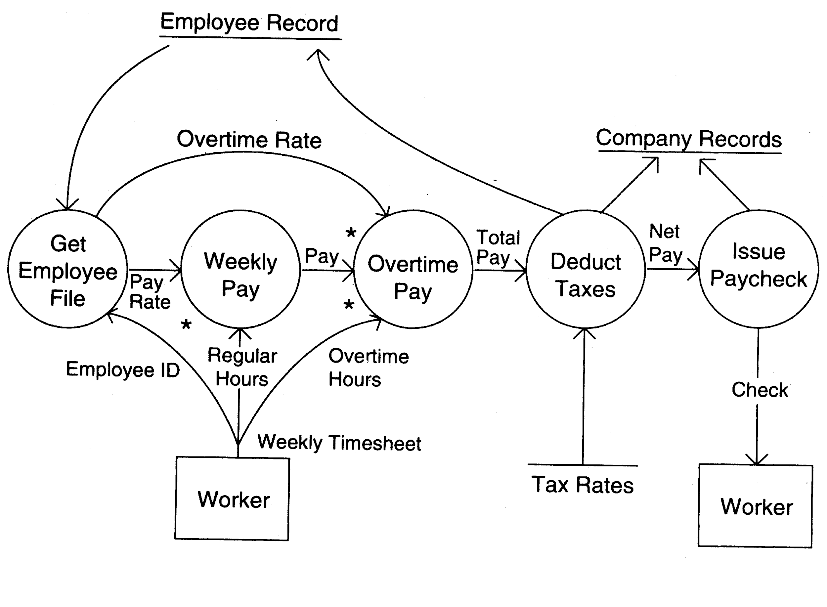
DFD Example
Requirements
‹#›

Slide 23
DFD Conventions
External files shown as labeled straight lines
Need for multiple data flows by a process represented by * (means and)
OR relationship represented by +
All processes and arrows should be named
Processes should represent transforms, arrows should represent some data
Requirements
‹#›

Slide 24
Data flow diagrams…
Focus on what transforms happen , how they are done is not important
Usually major inputs/outputs shown, minor are ignored in this modeling
No loops , conditional thinking , …
DFD is NOT a control chart, no algorithmic design/thinking
Sink/Source , external files
Requirements
‹#›

Slide 25
Drawing a DFD
If get stuck , reverse direction
If control logic comes in , stop and restart
Label each arrows and bubbles
Make use of + & *
Try drawing alternate DFDs
Leveled DFDs :
DFD of a system may be very large
Can organize it hierarchically
Start with a top level DFD with a few bubbles
then draw DFD for each bubble
Preserve I/O when “ exploding”
Requirements
‹#›

Slide 26
Drawing a DFD for a system
Identify inputs, outputs, sources, sinks for the system
Work your way consistently from inputs to outputs, and identify a few high-level transforms to capture full transformation
If get stuck, reverse direction
When high-level transforms defined, then refine each transform with more detailed transformations
Requirements
‹#›

Slide 27
Drawing a DFD for a system..
Never show control logic; if thinking in terms of loops/decisions, stop & restart
Label each arrows and bubbles; carefully identify inputs and outputs of each transform
Make use of + & *
Try drawing alternate DFDs
Requirements
‹#›

Slide 28
Leveled DFDs
DFD of a system may be very large
Can organize it hierarchically
Start with a top level DFD with a few bubbles
then draw DFD for each bubble
Preserve I/O when “ exploding” a bubble so consistency preserved
Makes drawing the leveled DFD a top-down refinement process, and allows modeling of large and complex systems
Requirements
‹#›

Slide 29
Data Dictionary
In a DFD arrows are labeled with data items
Data dictionary defines data flows in a DFD
Shows structure of data; structure becomes more visible when exploding
Can use regular expressions to express the structure of data
Requirements
‹#›

Slide 30
Data Dictionary Example
For the timesheet DFD
Weekly_timesheet – employee_name + id + [regular_hrs + overtime_hrs]*
Pay_rate = [hourly | daily | weekly] + dollar_amt
Employee_name = last + first + middle
Id = digit + digit + digit + digit
Requirements
‹#›

Slide 31
DFD drawing – common errors
Unlabeled data flows
Missing data flows
Extraneous data flows
Consistency not maintained during refinement
Missing processes
Too detailed or too abstract
Contains some control information
Requirements
‹#›

Slide 32
Structured Analysis Method
Structured system analysis and design (SSAD) – we will focus only on analysis
Was used a lot when automating existing manual systems
Main steps
Draw a context diagram
Draw DFD of the existing system
Draw DFD of the proposed system and identify the man-machine boundary
Requirements
‹#›

Slide 33
Context Diagram
Views the entire system as a transform and identifies the context
Is a DFD with one transform (system), with all inputs, outputs, sources, sinks for the system identified
Requirements
‹#›

Slide 34
DFD of the current system
The current system is modeled as-is as a DFD to understand the working
The context diagram is refined
Each bubble represents a logical transformation of some data
Leveled DFD may be used
Generally obtained after understanding and interaction with users
Validate the DFD by walking through with users
Requirements
‹#›

Slide 35
Modeling the Proposed System
No general rules for drawing the DFD of the future system
Use existing system understanding
DFD should model the entire proposed system - process may be automated or manual
validate with the user
Then establish man-machine boundary
what processes will be automated and which remains manual
Show clearly interaction between automated and manual processes
Requirements
‹#›

Slide 36
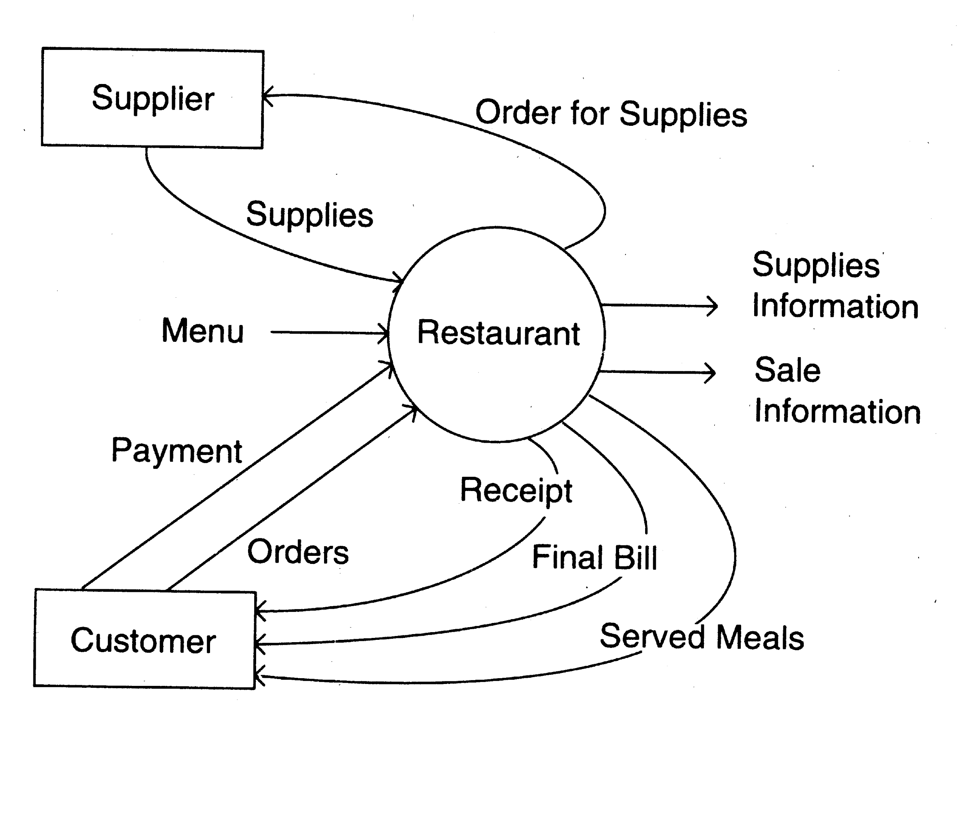
Example – context diagram
Requirements
‹#›

Slide 37
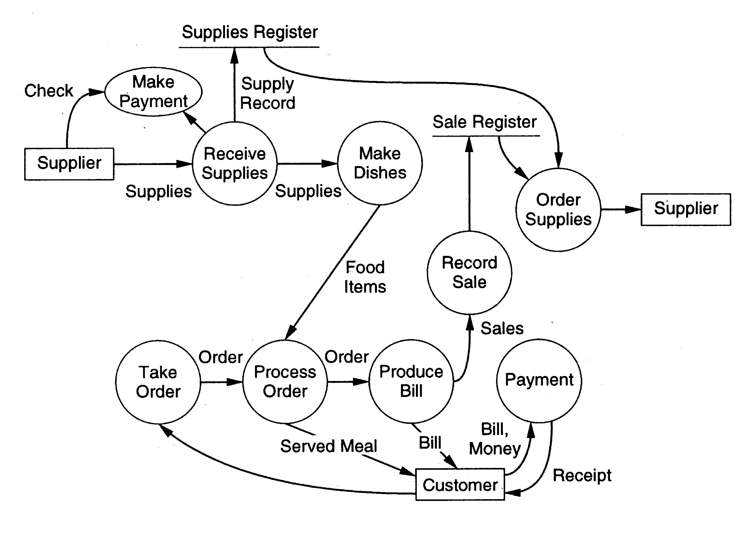
Example – DFD of existing sys
Requirements
‹#›

Slide 38
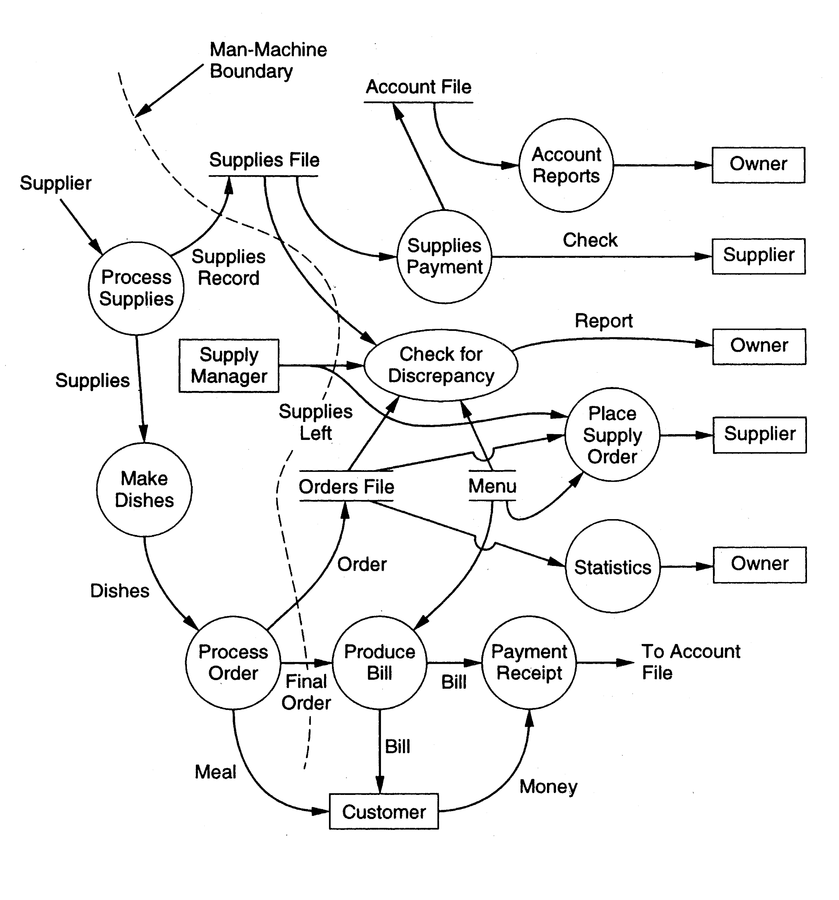
Example – DFD of proposed system
Requirements
‹#›

Slide 39
Other Approaches to RA
Prototyping
Evolutionary
Throw-away
Object Oriented
Classes, attributes, methods
Association between classes
Class hierarchies
The OOD approach is applied, except to the problem domain
Requirements
‹#›

Slide 40
Requirements Specification
Final output of requirements task is the SRS
Why are DFDs, OO models, etc not SRS ?
SRS focuses on external behavior, while modeling focuses on problem structure
UI etc. not modeled, but have to be in SRS
Error handling, constraints etc. also needed in SRS
Transition from analysis to specification is not straight forward
knowledge about the system acquired in analysis used in specification
Requirements
‹#›

Slide 41
Characteristics of an SRS
Correct
Complete
Unambiguous
Consistent
Verifiable
Traceable
Modifiable
Ranked for importance and/or stability
Requirements
‹#›

Slide 42
Characteristics…
Correctness
Each requirement accurately represents some desired feature in the final system
Completeness
All desired features/characteristics specified
Hardest to satisfy
Completeness and correctness strongly related
Unambiguous
Each req has exactly one meaning
Without this errors will creep in
Important as natural languages often used
Requirements
‹#›

Slide 43
Characteristics…
Verifiability
There must exist a cost effective way of checking if sw satisfies requirements
Consistent
two requirements don’t contradict each other
Traceable
The origin of the req, and how the req relates to software elements can be determined
Ranked for importance/stability
Needed for prioritizing in construction
To reduce risks due to changing requirements
Requirements
‹#›

Slide 44
Components of an SRS
What should an SRS contain ?
Clarifying this will help ensure completeness
An SRS must specify requirements on
Functionality
Performance
Design constraints
External interfaces
Requirements
‹#›

Slide 45
Functional Requirements
Heart of the SRS document; this forms the bulk of the specs
Specifies all the functionality that the system should support
Outputs for the given inputs and the relationship between them
All operations the system is to do
Must specify behavior for invalid inputs too
Requirements
‹#›

Slide 46
Performance Requirements
All the performance constraints on the software system
Generally on response time , throughput etc => dynamic
Capacity requirements => static
Must be in measurable terms (verifiability)
Eg resp time should be xx 90% of the time
Requirements
‹#›

Slide 47
Design Constraints
Factors in the client environment that restrict the choices
Some such restrictions
Standard compliance and compatibility with other systems
Hardware Limitations
Reliability, fault tolerance, backup req.
Security
Requirements
‹#›

Slide 48
External Interface
All interactions of the software with people, hardware, and sw
User interface most important
General requirements of “friendliness” should be avoided
These should also be verifiable
Requirements
‹#›

Slide 49
Specification Language
Language should support desired char of the SRS
Formal languages are precise and unambiguous but hard
Natural languages mostly used, with some structure for the document
Formal languages used for special features or in highly critical systems
Requirements
‹#›

Slide 50
Structure of an SRS
Introduction
Purpose , the basic objective of the system
Scope of what the system is to do , not to do
Overview
Overall description
Product perspective
Product functions
User characteristics
Assumptions
Constraints
Requirements
‹#›

Slide 51
Structure of an SRS…
Specific requirements
External interfaces
Functional requirements
Performance requirements
Design constraints
Acceptable criteria
desirable to specify this up front.
This standardization of the SRS was done by IEEE.
Requirements
‹#›

Slide 52
Use Cases Approach
Traditional approach for fn specs – specify each function
Use cases is a newer technique for specifying behavior (functionality)
I.e. focuses on functional specs only
Though primarily for specification, can be used in analysis and elicitation
Can be used to specify business or org behavior also, though we will focus on sw
Well suited for interactive systems
Requirements
‹#›

Slide 53
Use Cases Basics
A use case captures a contract between a user and system about behavior
Basically a textual form; diagrams are mostly to support
Also useful in requirements elicitation as users like and understand the story telling form and react to it easily
Requirements
‹#›

Slide 54
Basics..
Actor: a person or a system that interacts with the proposed system to achieve a goal
Eg. User of an ATM (goal: get money); data entry operator; (goal: Perform transaction)
Actor is a logical entity, so receiver and sender actors are different (even if the same person)
Actors can be people or systems
Primary actor: The main actor who initiates a UC
UC is to satisfy his goals
The actual execution may be done by a system or another person on behalf of the Primary actor
Requirements
‹#›

Slide 55
Basics..
Scenario: a set of actions performed to achieve a goal under some conditions
Actions specified as a sequence of steps
A step is a logically complete action performed either by the actor or the system
Main success scenario – when things go normally and the goal is achieved
Alternate scenarios: When things go wrong and goals cannot be achieved
Requirements
‹#›

Slide 56
Basics..
A UC is a collection of many such scenarios
A scenario may employ other use cases in a step
I.e. a sub-goal of a UC goal may be performed by another UC
I.e. UCs can be organized hierarchically
Requirements
‹#›

Slide 57
Basics…
UCs specify functionality by describing interactions between actors and system
Focuses on external behavior
UCs are primarily textual
UC diagrams show UCs, actors, and dependencies
They provide an overview
Story like description easy to understand by both users and analysts
They do not form the complete SRS, only the functionality part
Requirements
‹#›

Slide 58
Example
Use Case 1: Buy stocks
Primary Actor: Purchaser
Goals of Stakeholders:
Purchaser: wants to buy stocks
Company: wants full transaction info
Precondition: User already has an account
Requirements
‹#›

Slide 59
Example …
Main Success Scenario
User selects to buy stocks
System gets name of web site from user for trading
Establishes connection
User browses and buys stocks
System intercepts responses from the site and updates user portfolio
System shows user new portfolio stading
Requirements
‹#›

Slide 60
Example…
Alternatives
2a: System gives err msg, asks for new suggestion for site, gives option to cancel
3a: Web failure. 1-Sys reports failure to user, backs up to previous step. 2-User exits or tries again
4a: Computer crashes
4b: web site does not ack purchase
5a: web site does not return needed info
Requirements
‹#›

Slide 61
Example 2
Use Case 2: Buy a product
Primary actor: buyer/customer
Goal: purchase some product
Precondition: Customer is already logged in
Requirements
‹#›

Slide 62
Example 2…
Main Scenario
Customer browses and selects items
Customer goes to checkout
Customer fills shipping options
System presents full pricing info
Customer fills credit card info
System authorizes purchase
System confirms sale
System sends confirming email
Requirements
‹#›

Slide 63
Example 2…
Alternatives
6a: Credit card authorization fails
Allows customer to reenter info
3a: Regular customer
System displays last 4 digits of credit card no
Asks customer to OK it or change it
Moves to step 6
Requirements
‹#›

Slide 64
Example – An auction site
Use Case1: Put an item for auction
Primary Actor: Seller
Precondition: Seller has logged in
Main Success Scenario:
Seller posts an item (its category, description, picture, etc.) for auction
System shows past prices of similar items to seller
System specifies the starting bid price and a date when auction will close
System accepts the item and posts it
Exception Scenarios:
-- 2 a) There are no past items of this category
* System tells the seller this situation
Requirements
‹#›

Slide 65
Example – auction site..
Use Case2: Make a bid
Primary Actor: Buyer
Precondition: The buyer has logged in
Main Success Scenario:
Buyer searches or browses and selects some item
System shows the rating of the seller, the starting bid, the current bids, and the highest bid; asks buyer to make a bid
Buyer specifies bid price, max bid price, and increment
Systems accepts the bid; Blocks funds in bidders account
System updates the bid price of other bidders where needed, and updates the records for the item
Requirements
‹#›

Slide 66
Exception Scenarios:
-- 3 a) The bid price is lower than the current highest
* System informs the bidder and asks to rebid
-- 4 a) The bidder does not have enough funds in his account
* System cancels the bid, asks the user to get more funds
Requirements
‹#›

Slide 67
Example –auction site..
Use Case3: Complete auction of an item
Primary Actor: Auction System
Precondition: The last date for bidding has been reached
Main Success Scenario:
Select highest bidder; send email to selected bidder and seller informing final bid price; send email to other bidders also
Debit bidder’s account and credit seller’s account
Transfer from seller’s account commission amount to organization’s account
Remove item from the site; update records
Exception Scenarios: None
Requirements
‹#›

Slide 68
Example – summary-level Use Case
Use Case 0 : Auction an item
Primary Actor: Auction system
Scope: Auction conducting organization
Precondition: None
Main Success Scenario:
Seller performs put an item for auction
Various bidders make a bid
On final date perform Complete the auction of the item
Get feed back from seller; get feedback from buyer; update records
Requirements
‹#›

Slide 69
Requirements with Use Cases
UCs specify functional requirements
Other req identified separately
A complete SRS will contain the use cases plus the other requirements
Note – for system requirements it is important to identify UCs for which the system itself may be the actor
Requirements
‹#›

Slide 70
Developing Use Cases
UCs form a good medium for brainstorming and discussions
Hence can be used in elicitation and problem analysis also
UCs can be developed in a stepwise refinement manner
Many levels possible, but four naturally emerge
Requirements
‹#›

Slide 71
Developing…
Actors and goals
Prepare an actor-goal list
Provide a brief overview of the UC
This defines the scope of the system
Completeness can also be evaluated
Main Success Scenarios
For each UC, expand main scenario
This will provide the normal behavior of the system
Can be reviewed to ensure that interests of all stakeholders and actors is met
Requirements
‹#›

Slide 72
Developing…
Failure conditions
List possible failure conditions for UCs
For each step, identify how it may fail
This step uncovers special situations
Failure handling
Perhaps the hardest part
Specify system behavior for the failure conditions
New business rules and actors may emerge
Requirements
‹#›

Slide 73
Developing..
The four levels can drive analysis by starting from top and adding details as analysis proceeds
UCs should be specified at a level of detail that is sufficient
For writing, use good technical writing rules
Use simple grammer
Clearly specify all parts of the UC
When needed combine steps or split steps
Requirements
‹#›

Slide 74
Requirements Validation
Lot of room for misunderstanding
Errors possible
Expensive to fix req defects later
Must try to remove most errors in SRS
Most common errors
Omission - 30%
Inconsistency - 10-30%
Incorrect fact - 10-30%
Ambiguity - 5 -20%
Requirements
‹#›

Slide 75
Requirements Review
SRS reviewed by a group of people
Group: author, client, user, dev team rep.
Must include client and a user
Process – standard inspection process
Effectiveness - can catch 40-80% of req. errors
Requirements
‹#›

Slide 76
Sizing With Function Points
Requirements
‹#›

Slide 77
Sizing
Effort for project depends on many factors
Size is the main factor – many experiments and data analysis have validated this
Size in the start is only an estimate; getting size estimates from requirement is hard
Need a size unit that can be “computed” from requirements
Function points attempt to do this
Requirements
‹#›

Slide 78
Function Points
Is a size measure like LOC
Determined from SRS
Defines size in terms of “ functionality “
Why “measure” size early ?
Needed for estimation and planning
Five different parameters
external input type
external output type
logical internal file type
external interface file type
external inquiry type
Requirements
‹#›

Slide 79
Function Points…
These five parameters capture the functionality of a system
within a type , an element may be simple , average or complex
A weighted sum is taken
External input type :
each unique input type
A input type is unique if the format is different from others or if the specifications require different processing.
Requirements
‹#›

Slide 80
Function Points…
Simple : a few data elements
Complex : many data elements and many internal files needed for processing
Only files needed by the application are counted. ( HW/OS config. Files are are not counted )
External output type :
each unique output that leave system boundary
E.g.
Reports , messages to user , data to other applications
Simple : few columns
Requirements
‹#›

Slide 81
Function Points…
Average : many columns
Complex : references many files for production
Logical internal file type :
An application maintains information internally for its own processes
Each logical group of data generated , used and maintained
Same for simple , average and complex
Requirements
‹#›

Slide 82
Function Points…
External interface file type
logical files passed between application
External inquiry type
input , output combination
Weights
External Input 3 4 6
External Output 4 5 7
Logical int. file 7 10 15
External int. file 5 7 10
External inquiry 3 4 6
Requirements
‹#›

Slide 83
Function Points…
Unadjusted function point :
Basic function points
Adjusted for other factors
14 such factors
performance objectives , transaction rate etc.
Final FP is adjusted
differs at most 35%
Requirements
‹#›

Slide 84
Function Points…
Interest in FP
since obtained at requirements => major advantage
Well correlated with size
in some what interchangeable and tables exist
1 FP = 70 LOC of C
Works well for MIS , but not for system type
Major draw back - subjectivity
not repeatable
not precisely known ever for a built system
not addictive
Requirements
‹#›

Slide 85
Summary
Having a good quality SRS is essential for Q&P
The req. phase has 3 major sub phases
analysis , specification and validation
Analysis
for problem understanding and modeling
Methods used: SSAD, OOA , Prototyping
Key properties of an SRS: correctness, completeness, consistency, traceablity, unambiguousness
Requirements
‹#›

Slide 86
Summary..
Specification
must contain functionality , performance , interfaces and design constraints
Mostly natural languages used
Use Cases is a method to specify the functionality; also useful for analysis
Validation - through reviews
Function point is a size metric that can be extracted from the SRS
Requirements
‹#›

